Slide 1
MLB Postseason Roster Web Application
Matt Gates, Tanner Graham, Cade McPartlin

Slide 2
Table of Contents
MongoDB (Database)
Flask (API)
Bootstrap (GUI)

Slide 3
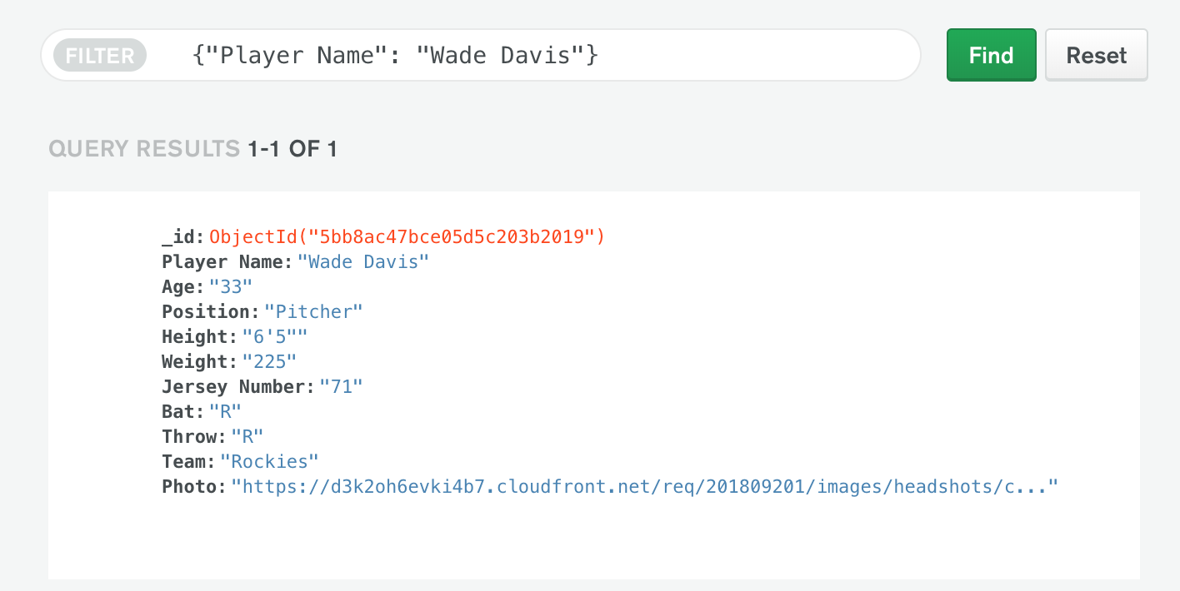
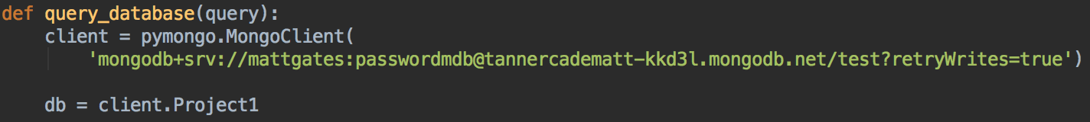
MongoDB Atlas
Setup database
Add items to the database
Link Python to MongoDB with PyMongo
Query MongoDB for database items

Slide 4
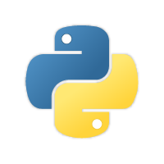

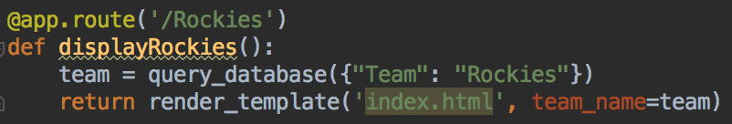
Python
Flask for creation of application routes
Pymongo for connection to database
Query information from database
Pass list of each team to Flask route

Slide 5
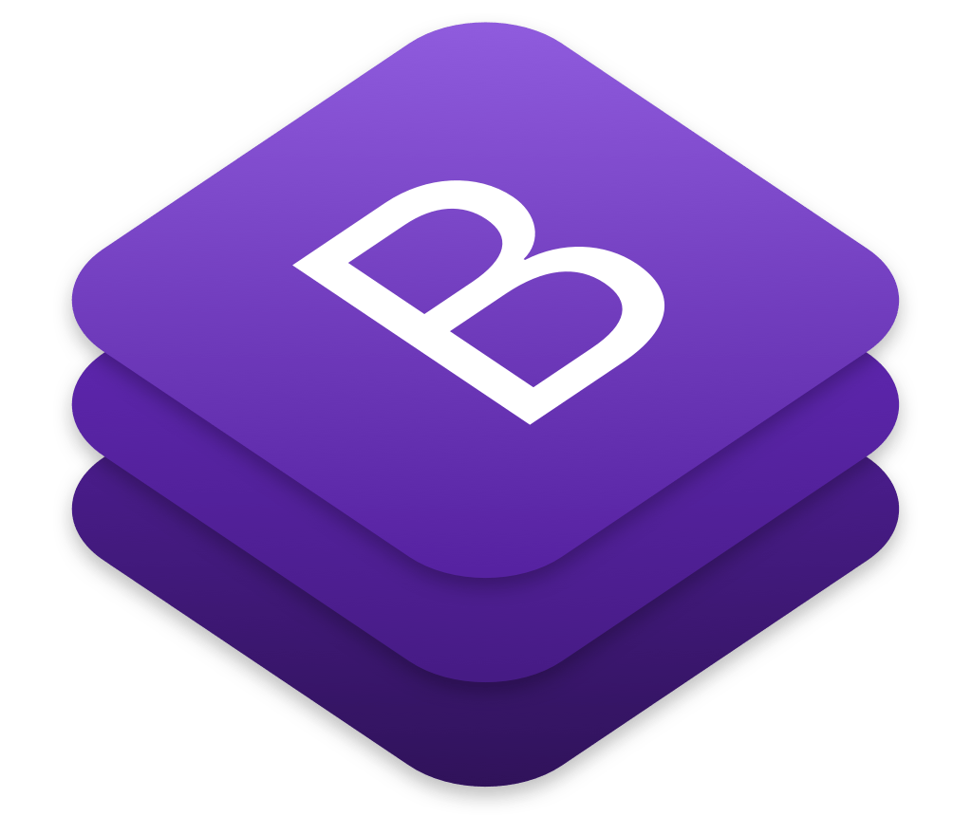
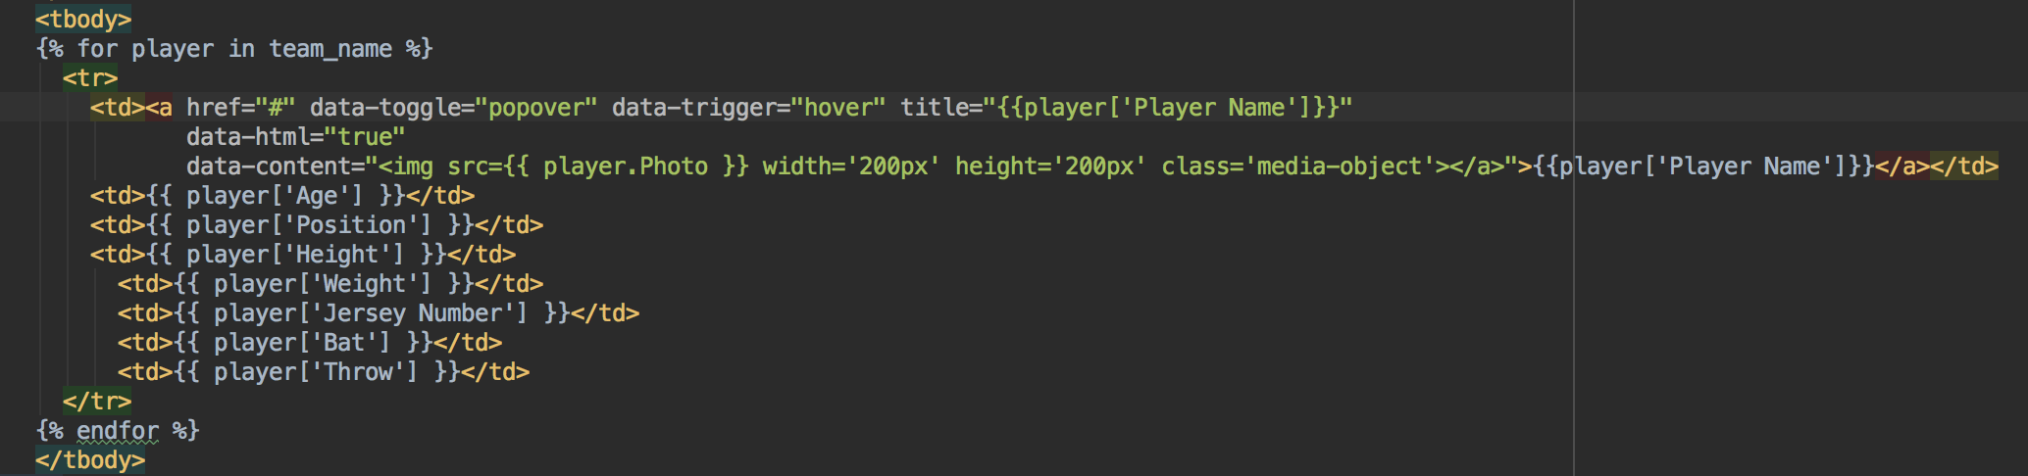
Bootstrap GUI
Bootstrap for major UI design
Python to dynamically generate information from database
JavaScript for popover feature

